Slide 1
Decision Trees

Slide 2
Decision Making
We will discuss some entry level decision making
Decision Trees & State Machines
Decision Making
Ability for a character to decide what to do
Can range from movement, animation, and behavior

Slide 3
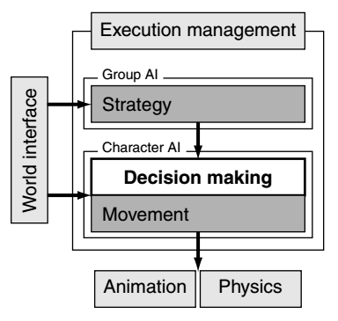
Decision Making
Overview
Process a set of information
Generate an action based on result

Slide 4
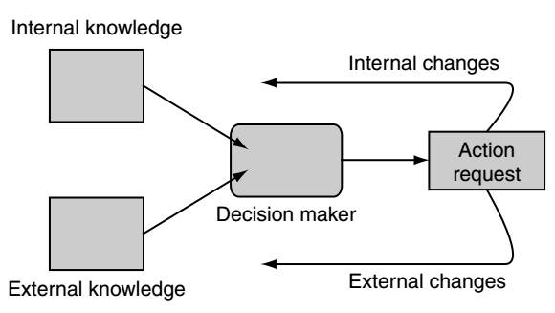
Decision Making
AI Model
External Knowledge
Information that character knows about the world
Internal Knowledge
Information that character knows about itself

Slide 5
Decision Trees
Pros
Fast, easy to code, simple to understand, modular
Cons
Limited in scope, scalability problems.
Don’t introduce higher level AI concepts unless your game calls for it.
Why use a neural network where a simple decision tree solves your problem.

Slide 6
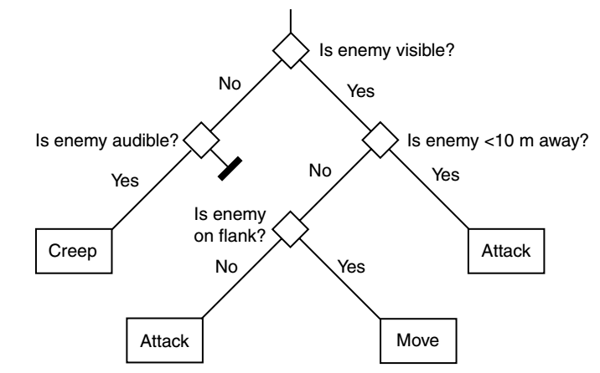
Decision Trees
Algorithm

Slide 7
Decision Trees
Algorithm
For each Node
If node is a question
Evaluate each choice based on characters knowledge
Then move to the corresponding node, then go back to 1
Else
Execute the action

Slide 8
Decision Trees
Data Type
Boolean
Enumeration
Numeric Value
3D Vector
Decisions
Value is true
Matches a given value
Value is within range
Length is in given range

Slide 9
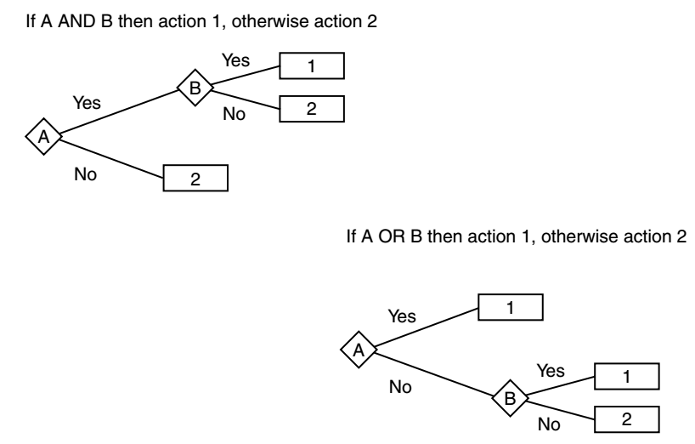
Decision Trees
You can represent “AND” and “OR” as well

Slide 10
Psuedo Code
Lets UML this idea!
What classes stick out to you?
Base Classes
Action (node)
Decision (node)
DecisionTree (tree)
Or just have root node

Slide 11
Board Work

